Slide 1
A Whole Team Approach To Testing
Jon Kruger
Twitter // @JonKruger
Email // jon@jonkruger.com
Blog // http://jonkruger.com

Slide 2
Columbus ATDD Developers Group
For anyone who cares about acceptance testing tools and practices
1st Thursday of every month during lunch
Google “columbus atdd”

Slide 3
Dude, this isn’t a QA conference

Slide 4
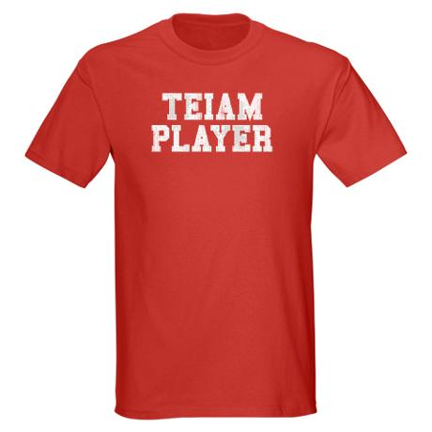
Notes:
We need to treat software teams like an actual team! Not siloes of people who act independently of each other without caring about other silos within the group

Slide 5

Notes:
On most software projects, developers write code and throw it over the wall to QA. Good luck QA team!

Slide 6
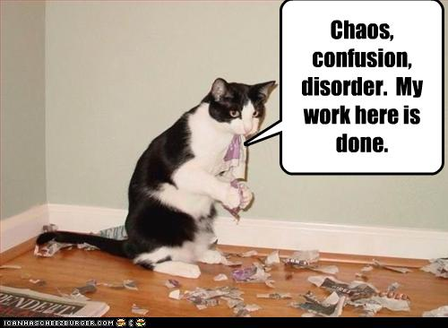
Notes:
QA is confused – they get a feature to test, but this is the first time that they have ever seen the details about the feature. How do we expect them to do a good job of testing it if they have no idea what it’s supposed to do? Not only that, but in some cases the developer finished working on the feature weeks ago and has moved onto something else long ago.

Slide 7
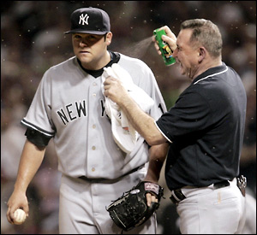
Notes:
This approach usually ends with lots of bugs.

Slide 8

QA death march
Notes:
This approach usually ends with lots of bugs.

Slide 9
What are we building?
Notes:
- When this happens, we don’t really know what we’re building. BAs write requirements with one thing in mind, developers interpret another way, and QAs then interpret it another way.
- This just makes you mad at QA for writing up bugs that aren’t bugs

Slide 10
A new way forward
Notes:
- What if we tried to communicate better as a team so that we could have less confusion?
- What if we tried to get QA to help developers not write bugs in the first place?

Slide 11

QA is not…
Notes:
QA is not an external auditor that is going to come sometime when you’re not expecting it to make sure that you’re following all of the rules.
QA teams should provide “independent verification”, but that doesn’t mean that you can’t work together with them to make sure that your code is correct.

Slide 12

QA is not…
Notes:
QA is not like taking an exam in a college class, where you take your best shot at interpreting requirements and then have the QA person “grade” how well you did.
We want to do whatever we can to get it 100% right. Imagine taking a test in your college class, having it be an open book test, and having the professor sitting next to you so that you ask him anytime if you’re doing it right.
Or better yet, what if we had the questions for the test ahead of time, we also had the answers for the test, and we had some hints on how to solve some of the complicated questions? (And you have the professor helping you) – remember, all we are doing is translating requirements into code. We aren’t here to interpret it in our own way, we are just translating.

Slide 13
Working Together
How is QA going to test the feature?
How do developers know when they’re done?
How can developers help QA?
Notes:
If I had a list of QA’s test cases before I write code, I should be able to write my code to make all of their test cases pass, and then I shouldn’t have any bugs.
But wait, some say, won’t you just write your code to make the tests pass? Exactly!!

Slide 14
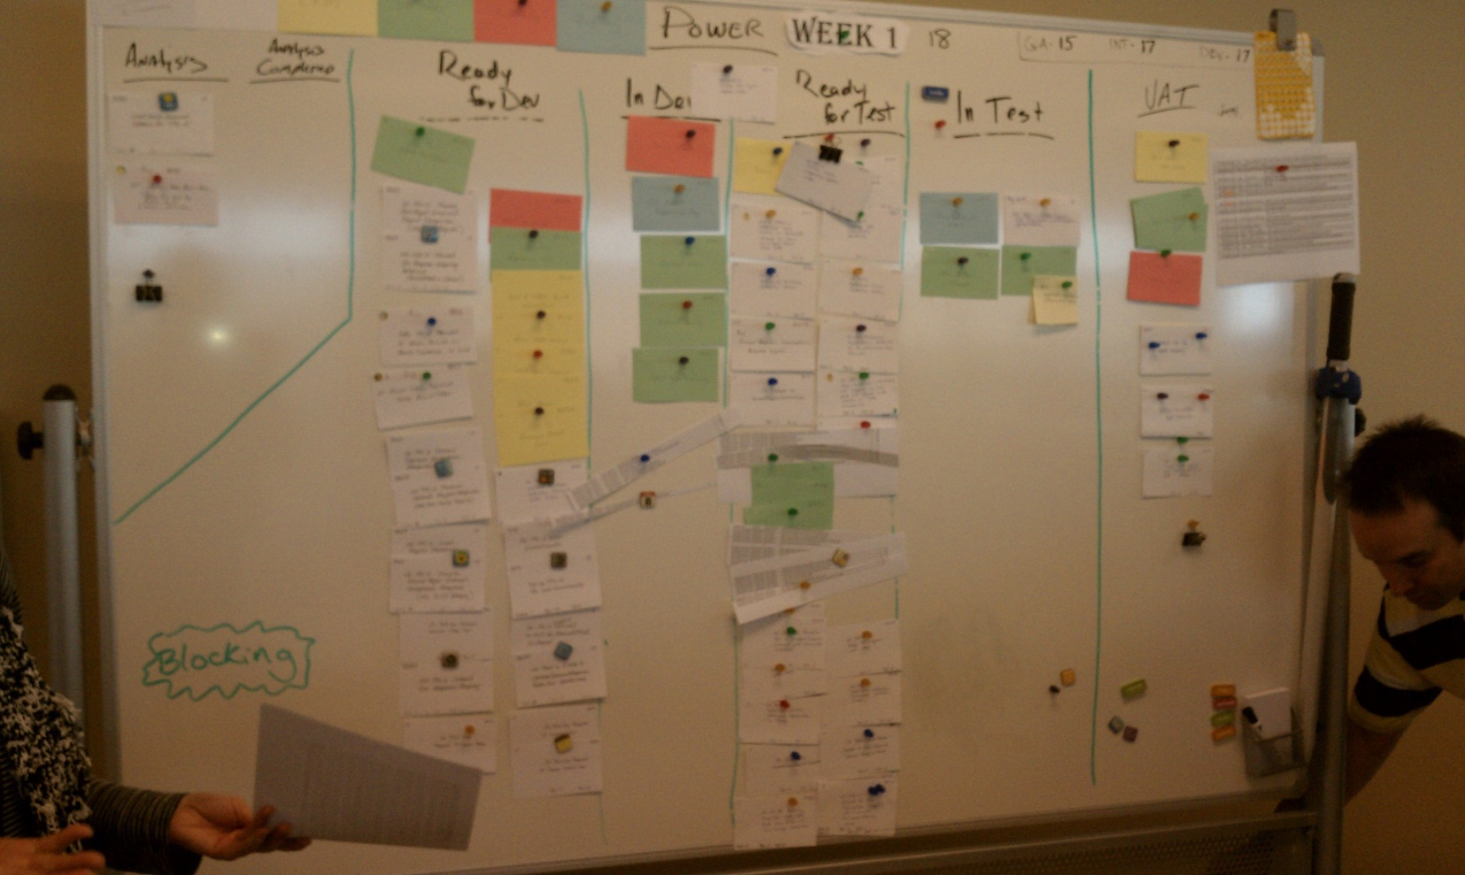
The Old Way
Notes:
Notice the pileup of cards in the “Ready for Test” queue, the cards clipped together, and the printouts of Excel bug lists. Also, the QA environment has code from iteration 15 and the integration testing environment has code from iteration 17, so the code going to production is over a month old! Mass chaos!!

Slide 15
The Three Amigos
Notes:
Get a BA, QA, and a developer in a room and discuss a feature before you start developing it. The outcome of this process (not necessarily the meeting itself) should be agreed upon acceptance criteria that indicate all details about what is going to be built and how QA will verify that it is working correctly.

Slide 16
Acceptance Criteria
Given I am a logged in user
When I go to the final checkout page
Then I should see the total cost of the order broken down by product cost, tax, and shipping charges
And I should see the total cost of the order
The “Gherkin” syntax
Notes:
The “Gherkin” syntax is a common grammar and syntax that we can use so that BAs, QAs, developers, and business people can speak the same language and ensure that everyone agrees on what is going to be built.

Slide 17
Feature: Process an order
Given I am a logged in user
When I go to the final checkout page
Then I should see the total cost of the order broken down
by product cost, tax, and shipping charges
And I should see the total cost of the order
Order total = total cost of products on the order + tax + shipping charges
Tax:
Ohio = 7%
Michigan = 6.5%
Other states = 0%
Shipping:
If total cost of products (before tax >= $25), shipping is free, otherwise $5

Slide 18
Feature: Process an order
Given I am a logged in user
When I go to the final checkout page
Then I should see the total cost of the order broken down
by product cost, tax, and shipping charges
And I should see the total cost of the order
Order total = total cost of products on the order + tax + shipping charges
Tax:
Based on the shipping address, not the billing address
Tax charged on the sum of the cost of the products
Ohio = 7%
Michigan = 6.5%
Other states (including DC) = 0%
No shipping internationally
Shipping:
If total cost of products (before tax) >= $25, shipping is free, otherwise $5

Slide 19
Feature: Process an order – Testing Notes
We’ll test the following scenarios:
Order with multiple products
Ship to OH, MI, DC
Unit tests to verify tax calculation for all 51 states
Shipping < $25, = $25, > $25
Verify order totals
Notes:
This is as far as we go in our initial 3 amigos meeting. At this point we’ll break and someone will write out the gherkin for the acceptance tests and then we’ll review the gherkin once it’s written (no need for us all to sit in a room and watch someone type out gherkin).

Slide 20
Feature: Process an order – Testing Notes
Products | Tax | Shipping
Order with one product | Ship to Ohio (7% tax) | Cost of product = $24.99 (shipping is $5)
Order with one product | Ship to Michigan (6.5% tax) | Cost of product = $25 (shipping is free)
Order with multiple products | Ship to DC, billing address is Ohio (0% tax) | Cost of products = $25.01 (shipping is free)
Verifications
Total cost = sum of cost of products + tax + shipping
Notes:
Combine all of the scenarios so that we can have fewer automated tests to write.

Slide 21
Feature: Process an order – Acceptance Criteria
Scenario: Order with one product, ship to OH, total product cost < $25
Given I am a logged in user
And the shopping cart is empty
And I add a product costing $24.99 to the cart
And my shipping state is OH
And my billing state is OH
When I go to the final checkout page
Then the tax amount should be $1.75
And the shipping amount should be $5.00
And the order total should be $31.74
Notes:
- This gherkin essentially becomes our requirements, our test plan, our method of verifying that our feature will meet the needs of the business, and potentially an automated acceptance test.
- The gherkin can be written by anyone on the team. The 3 amigos must all agree on the final gherkin.
- Bonus points if you can get people in the business to write requirements for you in this format!

Slide 22
3 Amigos Tips and Tricks
Break things into small chunks
Insist on acceptance criteria being complete before development begins
“3 Amigos” is not just a meeting
Remember the end goal – defined acceptance criteria and shared knowledge
Notes:
Once your team gets more disciplined, you can start leaving blanks in your acceptance criteria if they’re minor enough that they don’t prevent you from starting development. But initially I wouldn’t recommend that because people are still getting used to the rhythm of the new process
“3 Amigos” usually starts with a meeting, but then you can go off an work separately to define all of the details, and then come back together to agree on the final acceptance criteria
Do what makes sense for you! There are more than one way to achieve the end goal, so do what works best for your team.

Slide 23
Automated Testing
Notes:
- If we’re taking a whole-team approach to testing, then we should use our development skills to help automate testing.

Slide 24
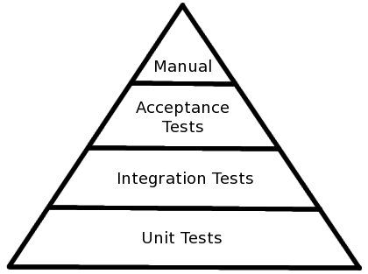
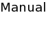
The automated testing triangle
Notes:
Let’s say that we decide as a team that we want our test breakdown to look like this. What is the best way to achieve this? Does it involve developers? (hint: yes)

Slide 25
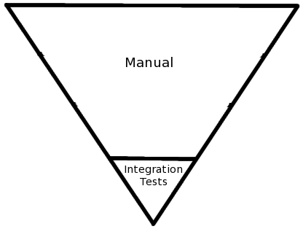
The (not) automated testing triangle
Notes:
The testing triangle at many shops would look like this…

Slide 26
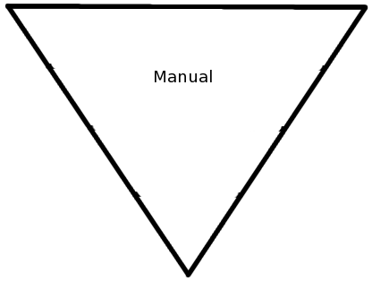
The (not) automated testing triangle
Notes:
… or sometimes it looks like this. Either of these inverted triangles show that the development team is not invested in the testing effort.

Slide 27
“What’s the best way to test this feature?”
Notes:
Remember, we are working a a TEAM!!!!!!!

Slide 28
Definition of Done

Slide 29
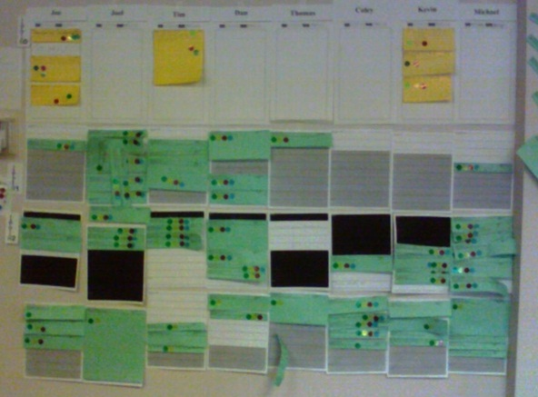
Notes:
What is the implied definition of done on this board? What are we incentivizing the development team to do?
“It will look good if I have a lot of red-dotted (dev complete) features on my sheet”
“If I don’t have a blue dot (testing complete) on the features on my sheet, it’s QA’s fault”

Slide 30
Definition of Done
=
Working Tested Features
=
In Production (or ready to go to production)

Slide 31
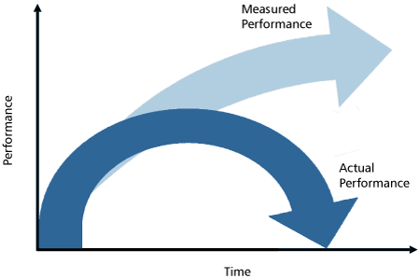
Definition of Done
Notes:
Stop lying to yourself about your progress!
All metrics (whether tracked or implied) should encourage the team to include testing as a part of “done”

Slide 32
Our old board

Slide 33
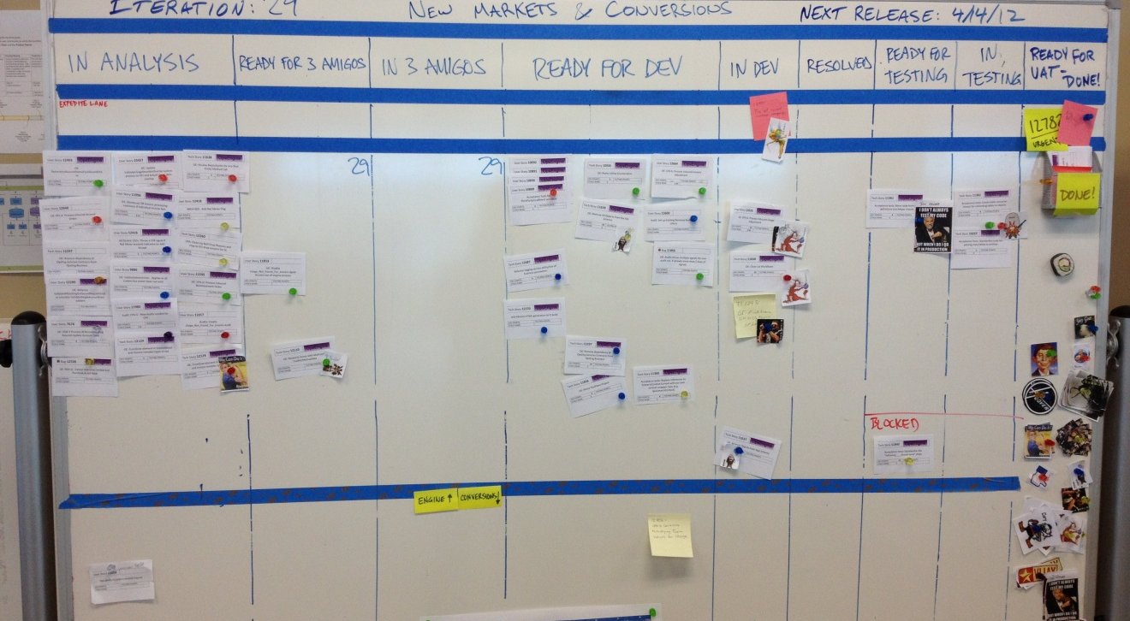
Our new board
Notes:
- Small testing columns limit the amount of work that can be “in testing”

Slide 34
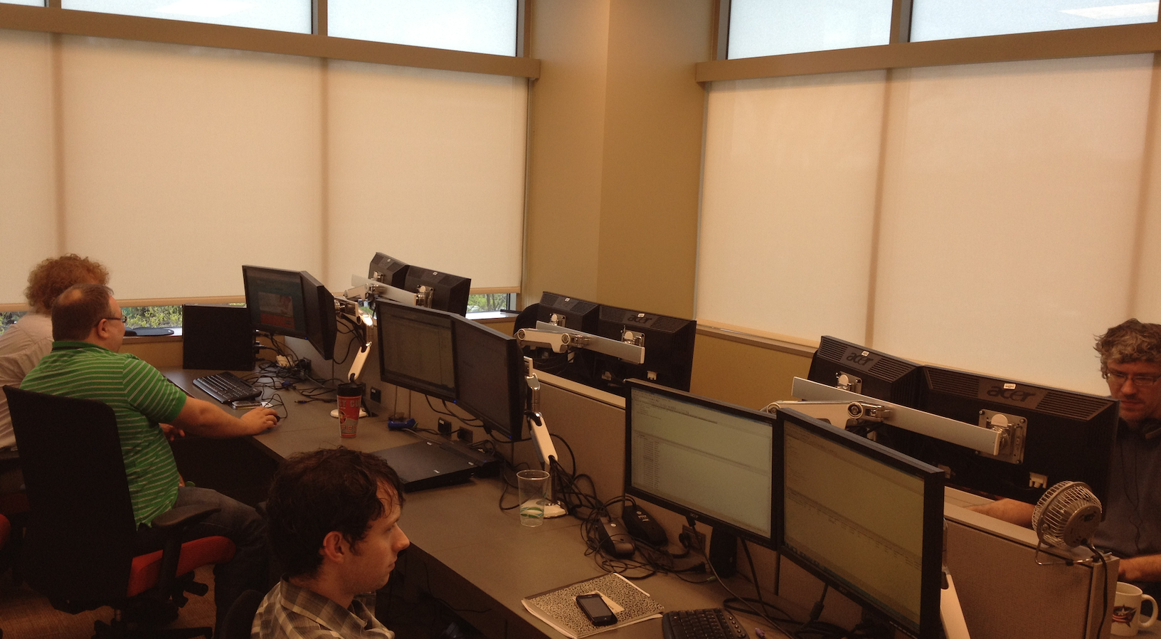
Co-location
Notes:
“The Pod”

Slide 35

Co-location
Notes:
Short cubicles, open area for people to meet. System analysts, developers, and QA people all sitting in the same row.
Having developers and QA people sit together helps break down the symbolic walls between developers and QA. It’s a lot easier to ask a QA person a question about what you’re developing when you turn around and ask someone a question or roll across the aisle and talk to them.

Slide 36
Management Structure
Notes:
If developers and QA people report to different managers, it’s tempting to not think of them as being on the same team.
Example: QA team is doing all manual testing and can’t keep up with the development team because manual testing takes too long. It might make sense to have a developer help automate some of the testing, but the development manager might not want to offer up one of his people to help the QA team because he might not want to “lose” one of his developers and therefore not get as much “done” (even though after all, it’s not done until it’s tested). The QA manager might not feel that he can ask the development manager for one of his people, so he might go out and hire more manual testers. In this case, managers are only looking out for their own interests, but this is encouraged by the management structure that is in place.

Slide 37
What things look like now
We go faster
QA people moving into analyst roles
QA people asking devs to automate testing for them
Automated tests driving quality
Rolling out ATDD to other teams

Slide 38
What can I do?
Address shared pain (QA and devs dealing with incomplete requirements)
Developers tell QA how they tested their code
Show that there is a problem (e.g. lots of time spent fixing bugs)
Have developers help test when QA is behind
Insist on acceptance criteria (regardless of who writes it)
Change your metrics
Make incremental progress

Slide 39
?

Slide 40
Slides and contact info
Slides:
http://jonkruger.com/,
click on Presentations
Email: jon@jonkruger.com
Twitter: @JonKruger
Blog: http://jonkruger.com

